Slide 1
SALOON MANAGEMENT APP MINI PROJECT
SUBMITTED TO ;
SATHEESH KUMAR SIR
ASSISTANT PROFFESSOR
MARIAN COLLEGE AUTONOMOUS KUTTIKKANAM
SUBMITTED BY ;
ALBIN VINSON
22PMC106
MCA FIRST YEAR

Slide 2
Table of Contents :
Abstract
Project requirements
Features and highlights
Technical aspects
Challenges faced
Conclusion

Slide 3
Abstract
The Saloon Management App Mini Project is a web-based application designed to help salon owners manage their business more efficiently. The app provides a range of features that allow salon owners to keep track of appointments, inventory, and staff schedules.
This mini project was undertaken as part of the second semester website project for Master of Computer Application course. The aim of this project was to develop an application that would be useful to small business owners in the salon industry.

Slide 4
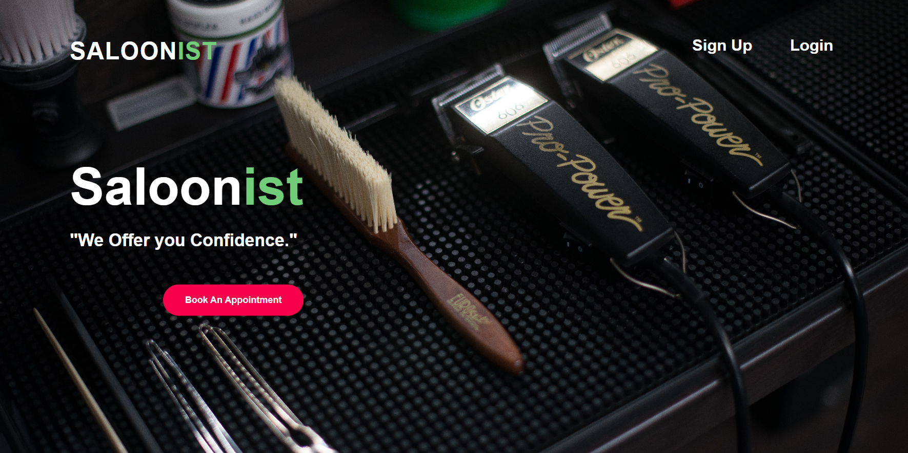

Slide 5
Project requirements
A functional device with a internet browser:
Google chrome/ MS Edge
Desktop /laptop / mobile phone browser
Basic storage requirements and network connectivity

Slide 6
Features and highlights
The Saloon Management App has several key features that make it an essential tool for salon owners.
One of the most important features is the appointment scheduler.
This allows salon owners to easily schedule appointments with clients and ensure that their staff is available to provide the necessary services.
The dashboard provides an overview of all the important information, such as upcoming appointments and inventory levels.

Slide 7
Technical aspects
The user interface of admin of the Saloon Management App is simple and intuitive and made from Django Jazzmin .
The Database has been designed to be easy to navigate, even for those who are not familiar with technology. The dashboard provides an overview of all the important information, such as upcoming appointments and inventory levels.
The Architecture is also easy to understand for basic salon owners and the code is written on Python with Django frameworks for better compatibility
The styling is done with the help of bootstrap and CSS for a colorful and yet interactive website

Slide 8
The Saloon Management App offers several benefits to salon owners. Firstly, it helps them save time by automating many of the tasks that would otherwise need to be done manually. This means that they can focus on providing high-quality services to their clients.
Secondly, the app helps salon owners stay organized and keep track of important information. This reduces the risk of double bookings, missed appointments, and stock shortages. Finally, the app helps salon owners make better business decisions by providing them with real-time data about their business performance.

Slide 9
Challenges faced
Developing the Saloon Management App was not without its challenges. One of the biggest challenges was ensuring that the app was user-friendly and easy to navigate. Another challenge was integrating all the different features into a cohesive system that worked seamlessly.
However, these challenges were overcome through careful planning and collaboration between team members. The end result is an app that is both functional and easy to use.

Slide 10
Conclusion
In conclusion, the Saloon Management App Mini Project is a valuable tool for salon owners who want to manage their business more efficiently. The app offers a range of features that help salon owners stay organized, save time, and make better business decisions.
Developing this app was a challenging but rewarding experience for the team. We are proud to have created an application that has the potential to make a real difference in the beauty industry.

Slide 11
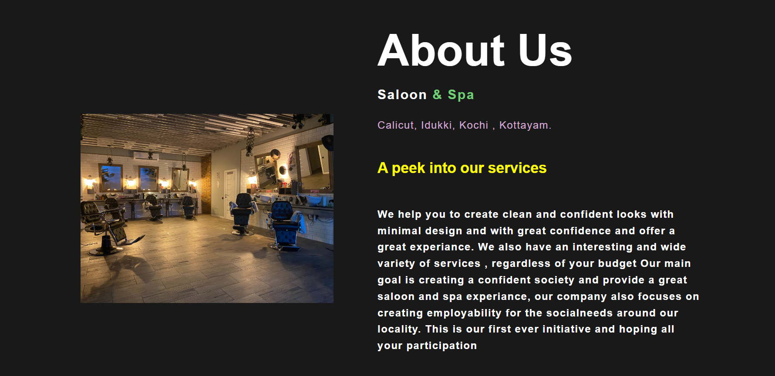
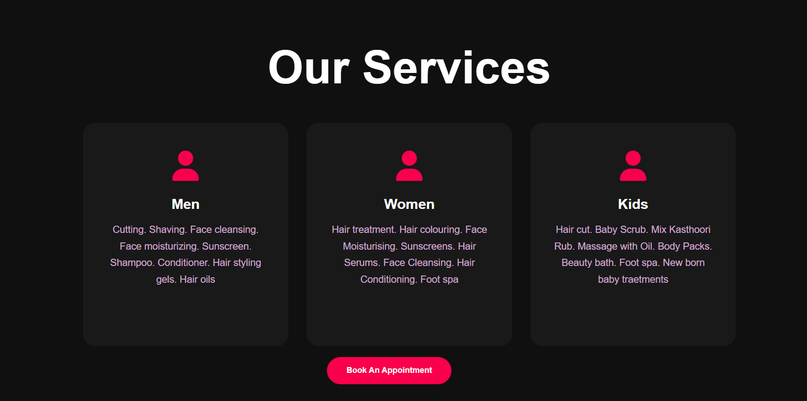
screenshots
home
About us
services

Slide 12
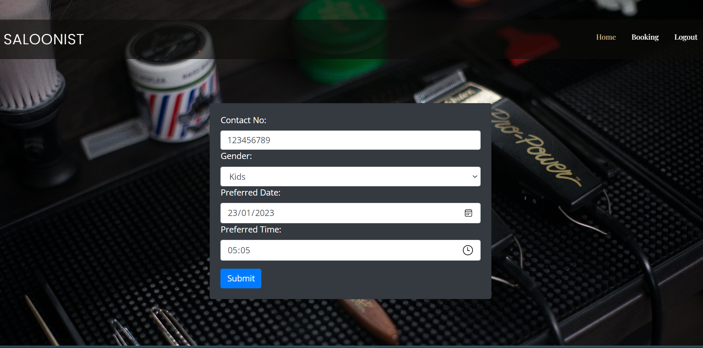
booking

Slide 13
Thank you

